Slide 1


Digital Egypt Pioneers
Data Analyst Specialist Track
Supply Chain Final Project
I-learn: CAI2_DAT1_G7

Slide 2
Data Analyst Specialist Track
Supply Chain Final Project
Digital Egypt Pioneers
Supply Chain Team
Mahmoud Ahmed
Muhammed Hatem
Omar Essam
Ghada Mohamed
Nada Khaled
Reem El-Husseiny
Under Supervision of:
Dr. Ahmed Samir

Slide 3
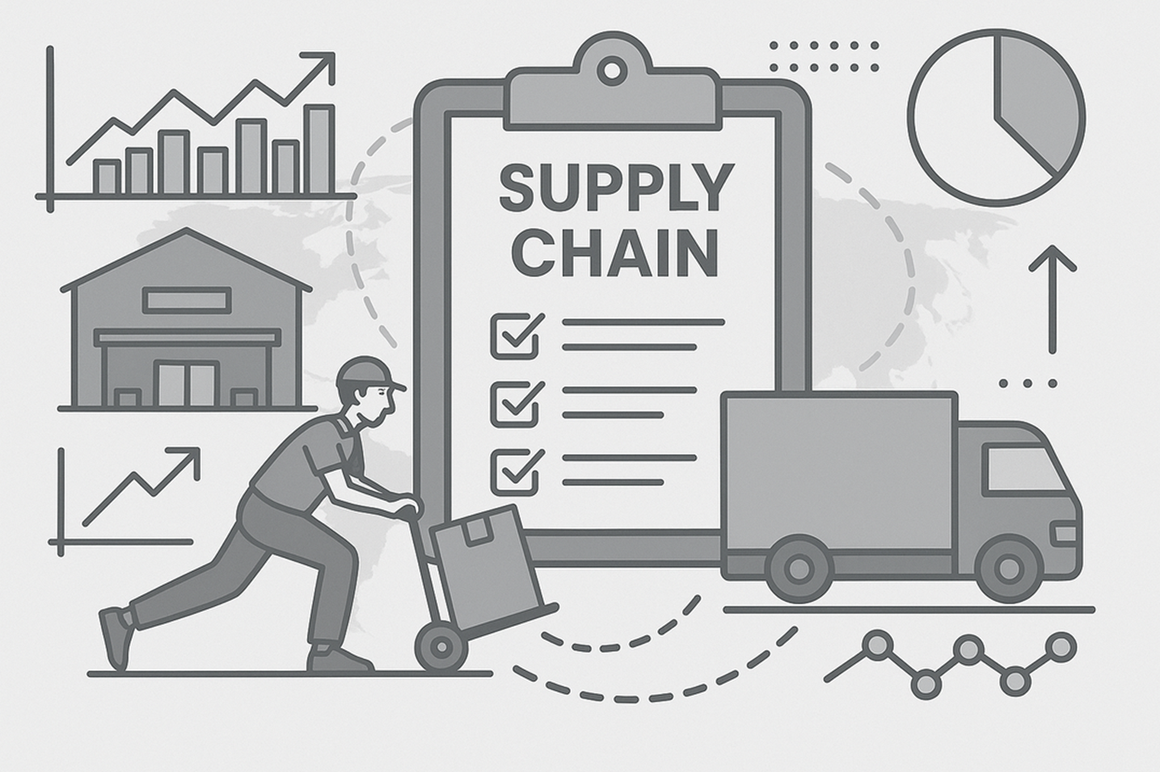
Data Analyst Specialist Track
Supply Chain Final Project
Digital Egypt Pioneers
What is Supply Chain?
Supply chain is the process of producing and delivering a product, from raw materials to the end customer, ensuring efficiency and cost effectiveness.
Supply Chain - Final Project

Slide 4
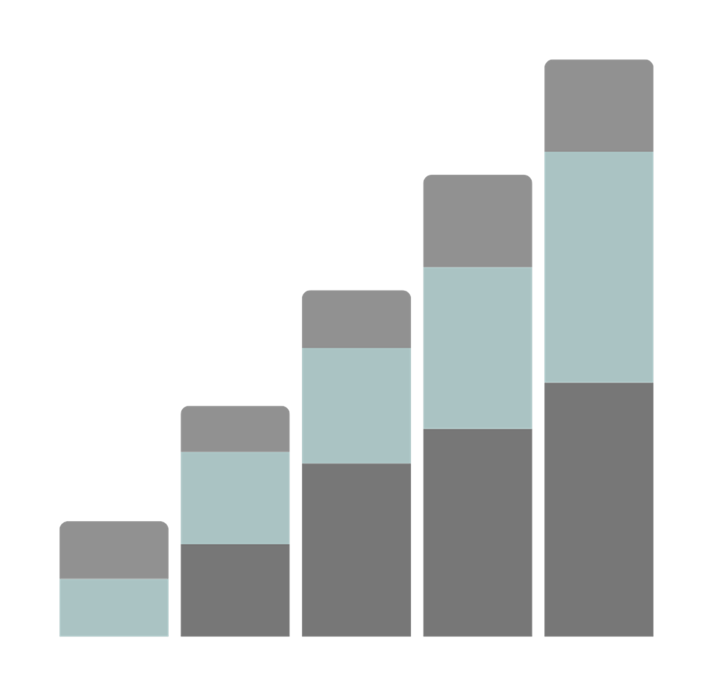
Data Analyst Specialist Track
Supply Chain Final Project
Digital Egypt Pioneers
Data Analysis in Supply chain
Data analysis helps businesses improve supply chain efficiency.
By examining data from sourcing to delivery, companies can predict trends, reduce costs, and make smarter decisions.
This presentation focuses on analyzing a supply chain dataset and how we can leverage different tools to enhance performance.
Supply Chain - Final Project

Slide 5




Data Analysis Tools
Digital Egypt Pioneers
Supply Chain - Final Project

Slide 6
Supply Chain Project Phases
Phase 1
Phase 2
Phase 3
Digital Egypt Pioneers
Data Exploration, Cleaning and Preprocessing
Analysis Questions Phase
Visualization Dashboard and
Recommendation
Supply Chain - Final Project

Slide 7
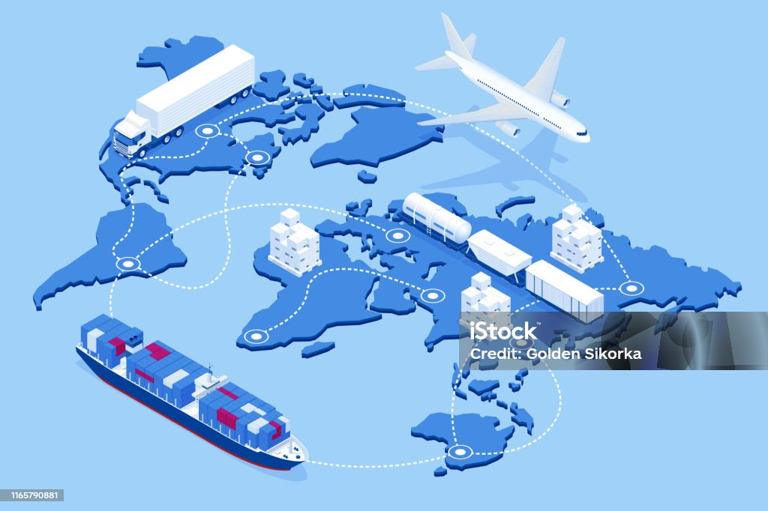
Supply Chain
Project
Outline
Digital Egypt Pioneers
1. Data Exploration, Cleaning and Preprocessing
2. Analysis Questions Phase
3. Visualization Dashboard
4. Final Recommendations
Supply Chain - Final Project

Slide 8

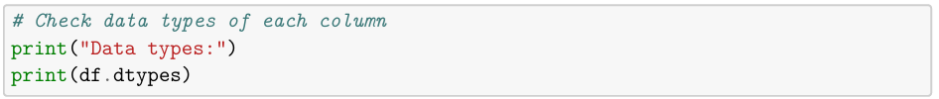
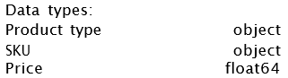
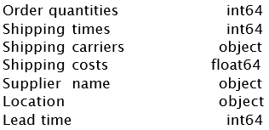
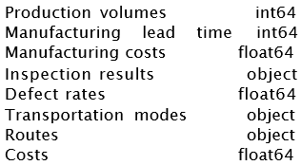
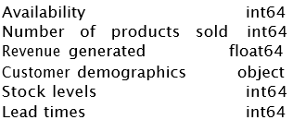
1. Data Exploration, Cleaning and Preprocessing
a) Data Exploration
Digital Egypt Pioneers
The provided dataset, named "supply_data," is a CSV file containing 100 transactions × 24 features (e.g., Product type, Customer, supplier, location and transportation mode).
Shape of the dataset: (100,24)
Supply Chain - Final Project

Slide 9
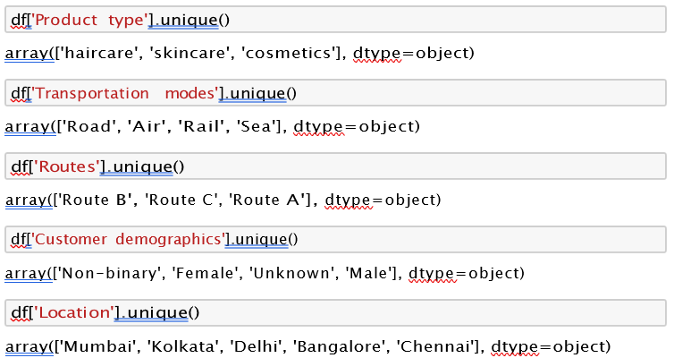
1. Data Exploration, Cleaning and Preprocessing
a) Data Exploration
Digital Egypt Pioneers
Supply Chain - Final Project

Slide 10








1. Data Exploration, Cleaning and Preprocessing
a) Data Exploration.
Digital Egypt Pioneers
Customer
Supplier
Inventory
Location
Transportation mode
Shipping Carrier
Supply Chain - Final Project

Slide 11
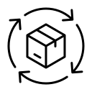
1. Data Exploration, Cleaning and Preprocessing
a) Data Exploration
i) Categorical Data
Digital Egypt Pioneers
Customer
Supplier
Product
Supplier 1
Supplier 2
Supplier 3
Supplier 4
Supplier 5
Female.
Male.
Unknown.
Non-binary
Skincare.
Haircare
Cosmetics
Transportation mode
Routes
Location
Kolkata
Mumbai
Chennai
Bangalore
Delhi
Road
Rail
Air.
Sea
Route A
Route B
Route C
Shipping Carrier
Carrier A
Carrier B
Carrier C
Supply Chain - Final Project

Slide 12

1. Data Exploration, Cleaning and Preprocessing
a) Data Exploration
i) Numerical Data
Digital Egypt Pioneers
Inventory
Product
Supplier
Lead time
Production volumes
Manufacturing lead time
Manufacturing costs
Inspection results
Defect rates
Availability
Stock levels
Delivery Lead time
Order quantities
Price
Availability
Number of Products sold
Revenue generated
Transportation mode
Routes
Shipping Carrier
Shipping times
Shipping costs
Supply Chain - Final Project

Slide 13
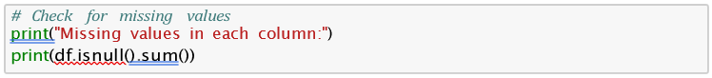
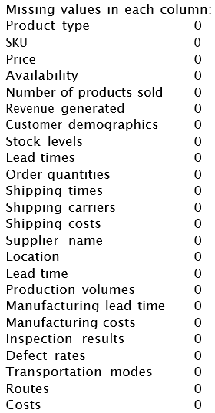
1. Data Exploration, Cleaning and Preprocessing
b) Data Cleaning
Digital Egypt Pioneers
No missing values in data
Number of duplicate rows: 0
Finally, the cleaned data was saved to a new CSV file:
The structured approach ensures that data integrity is maintained, and the cleaned data is ready for analysis.
Supply Chain - Final Project

Slide 14
Supply Chain
Project
Outline
Digital Egypt Pioneers
1. Data Exploration, Cleaning and Preprocessing
2. Analysis Questions Phase
3. Visualization Dashboard
4. Final Recommendations
Supply Chain - Final Project

Slide 15
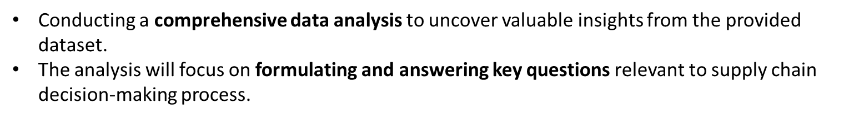
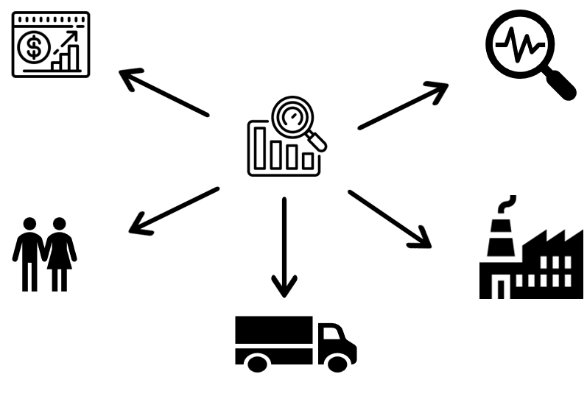
2. Analysis Questions Phase
Digital Egypt Pioneers
We separated the Data into 5 main categories for analysis:
Product Performance
Quality Analysis
Customer preferences
Supplier and manufacturing
Logistics and shipping
Supply Chain - Final Project

Slide 16


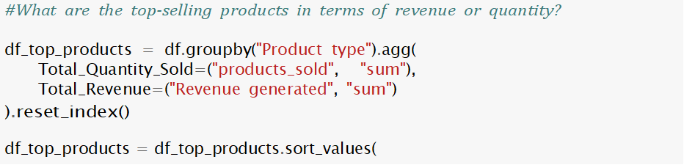
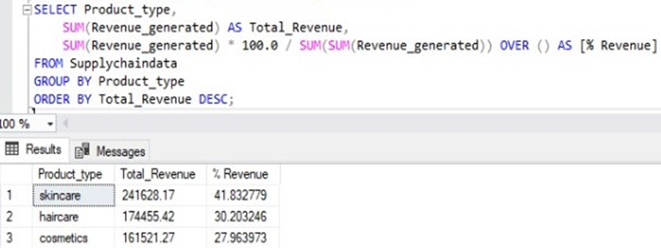
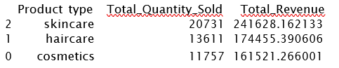
2. Analysis Questions Phase
i. Product Performance
Digital Egypt Pioneers
Q1. What are the top-selling products in terms of revenue or quantity?
Supply Chain - Final Project

Slide 17


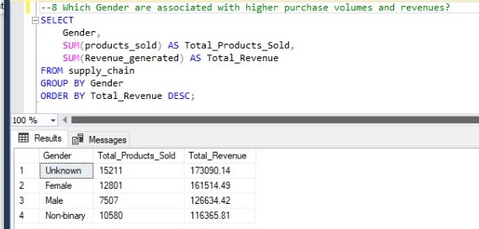
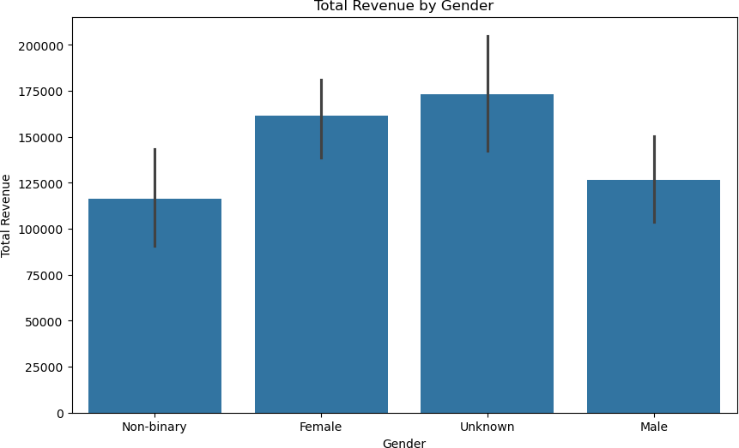
2. Analysis Questions Phase
ii. Customer preferences
Digital Egypt Pioneers
Q1. Which Gender are associated with higher purchase volumes and revenues?
plt.figure(figsize=(10, 6))
sns.barplot(data=df, x='Gender', y='Revenue generated', estimator=sum) plt.title('Total Revenue by Gender')
plt.xlabel('Gender') plt.ylabel('Total Revenue') plt.show()
Supply Chain - Final Project

Slide 18
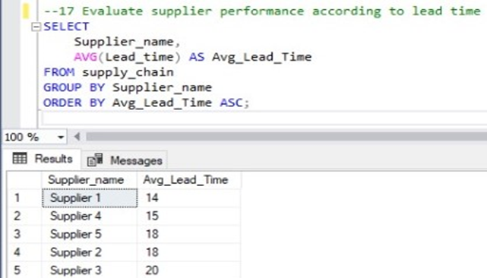
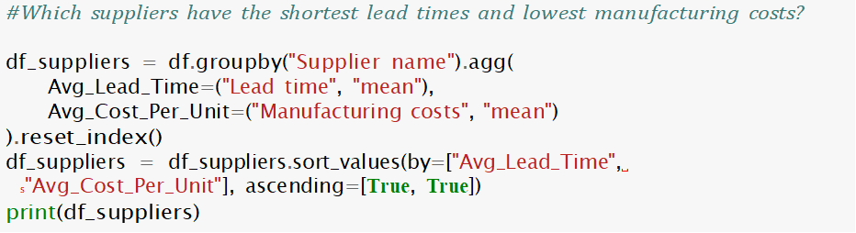
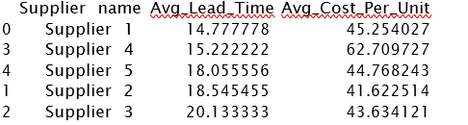
2. Analysis Questions Phase
iii. Supplier and manufacturing
Digital Egypt Pioneers
Q1. Evaluate supplier performance according to lead time
Supply Chain - Final Project

Slide 19

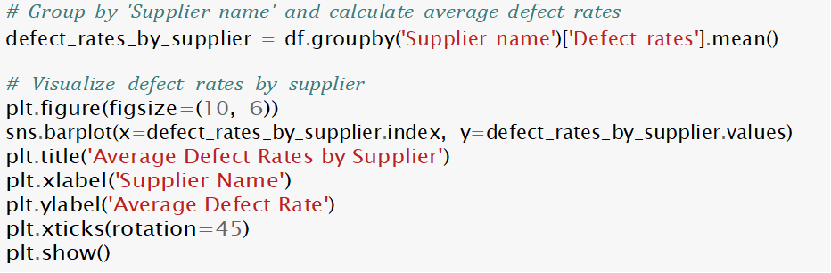
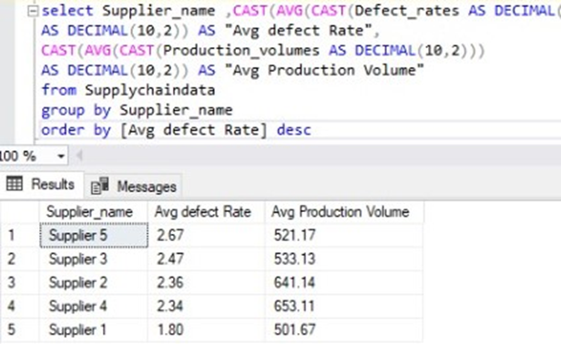
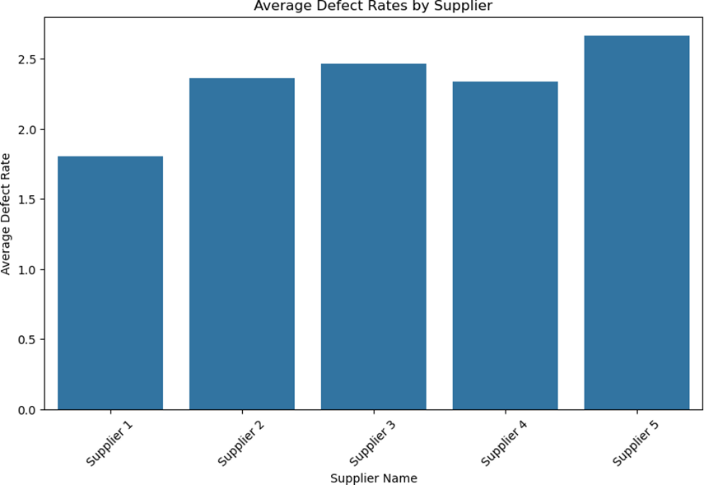
2. Analysis Questions Phase
iv. Quality Analysis
Digital Egypt Pioneers
Q1. Defect rates by supplier
Supply Chain - Final Project

Slide 20
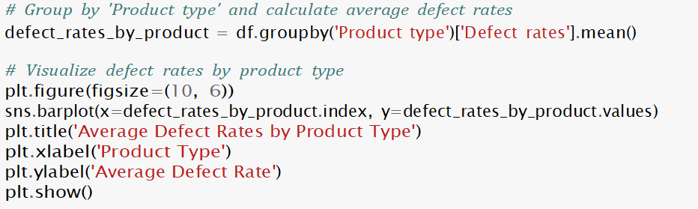
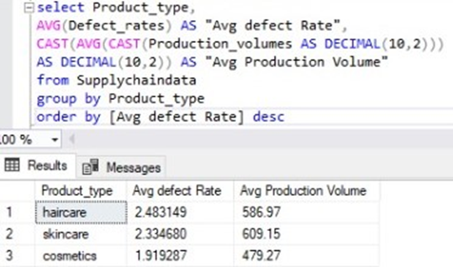
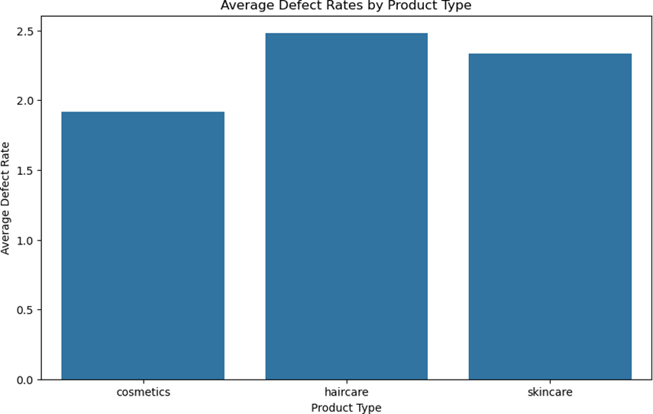
2. Analysis Questions Phase
iv. Quality Analysis
Digital Egypt Pioneers
Q2. Defect rates by product type
Supply Chain - Final Project

Slide 21

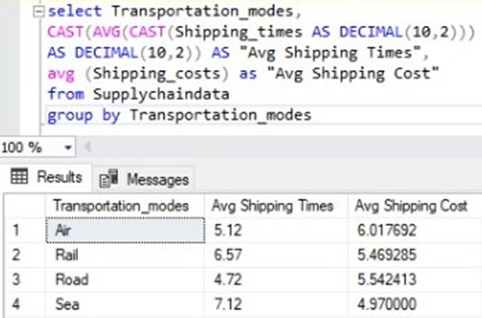
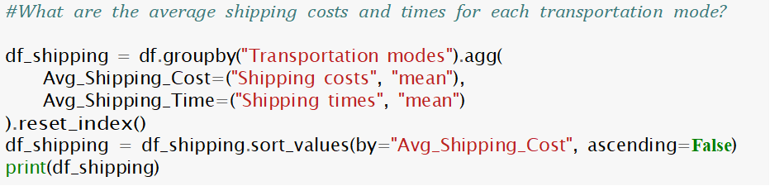
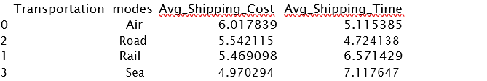
2. Analysis Questions Phase
v. Logistics and shipping
Digital Egypt Pioneers
Q1. How do different transportation modes compare in terms of average shipping time and cost?
Supply Chain - Final Project

Slide 22
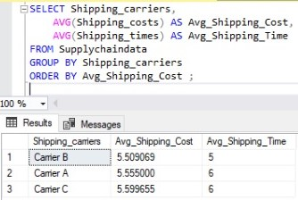
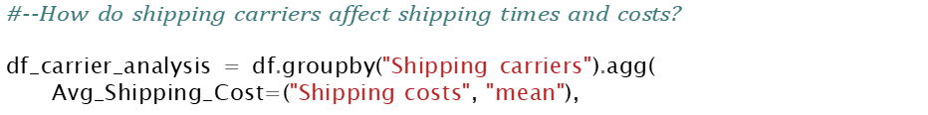
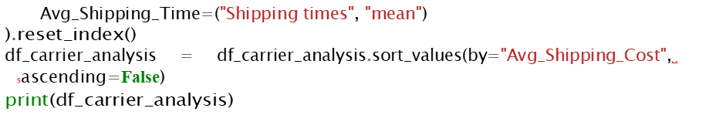
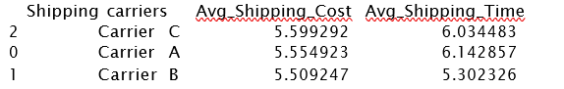
2. Analysis Questions Phase
v. Logistics and shipping
Digital Egypt Pioneers
Q2. How do shipping carriers affect shipping times and costs
Supply Chain - Final Project

Slide 23
Supply Chain
Project
Outline
Digital Egypt Pioneers
1. Data Exploration, Cleaning and Preprocessing
2. Analysis Questions Phase
3. Visualization Dashboard
4. Final Recommendations
Supply Chain - Final Project

Slide 24

3. Visualization Dashboard
By creating a comprehensive Tableau dashboard, we aim to transform the insights gained from our SQL queries into a visually compelling and interactive narrative.
We analyzed our data using 5 main dashboards.
Product Performance.
Customer preferences
Supplier and manufacturing.
Quality Analysis
Logistics and Shipping
Digital Egypt Pioneers
* For Tableau full Dashboard click here
Supply Chain - Final Project

Slide 25
Supply Chain
Project
Outline
Digital Egypt Pioneers
1. Data Exploration, Cleaning and Preprocessing
2. Analysis Questions Phase
3. Visualization Dashboard
4. Final Recommendations
Supply Chain - Final Project

Slide 26
4. Final Recommendations
I. Revenue Optimization
Digital Egypt Pioneers
Skincare Growth:
Top revenue driver (41.8%).
Action: Increase investment in range, marketing, visibility.
SKU Optimization:
High-potential SKUs have low sales; low-revenue SKUs underperform.
Action: Market high-potential SKUs, discontinue underperformers.
Haircare Margins:
High sales volume, low revenue.
Action: Renegotiate procurement prices.
Inventory Efficiency:
High stock-to-sales SKUs overstocked; low stock-to-sales SKUs require fast shipping.
Action: Postpone procurement for overstocked SKUs, prioritize rapid (road) shipment for low-stock SKUs.
Supply Chain - Final Project

Slide 27
4. Final Recommendations
II. Customer Preferences
Digital Egypt Pioneers
Gender Purchase Behavior
skincare products are a popular category among female customers. Consider focusing marketing efforts and product development on this segment to maximize sales and customer satisfaction.
Top Revenue Cities:
Mumbai & Kolkata are top cities for revenue & sales.
Action: Increase Availability of products in Mumbai & Kolkata
High Purchasing Ability Cities
•Bangalore has high revenue, lower sales (marketing opportunity).
Action: Increase Bangalore marketing to boost sales.
Supply Chain - Final Project

Slide 28

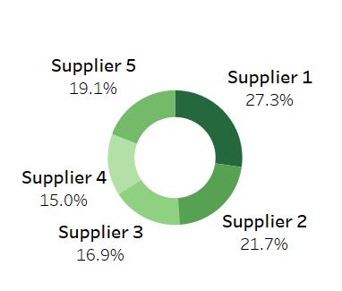
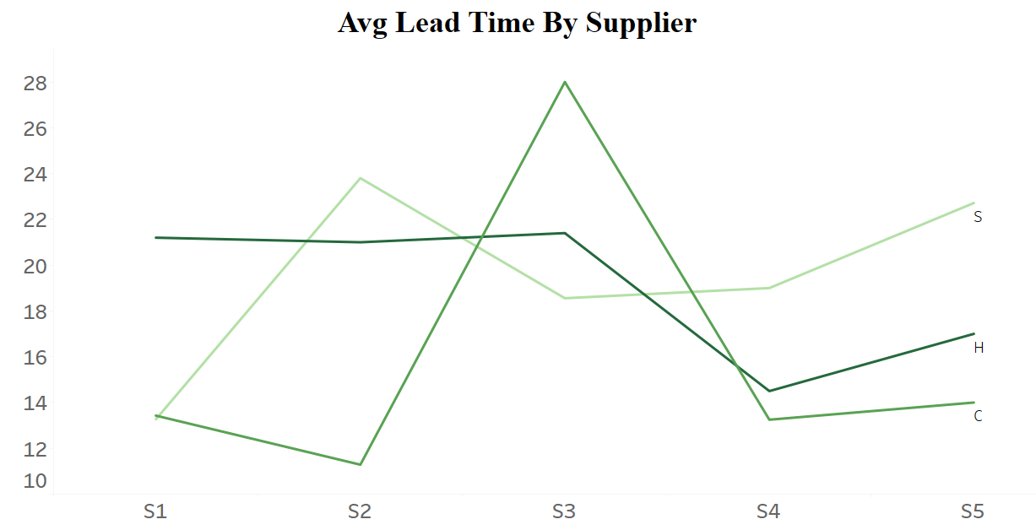
4. Final Recommendations
III. Supplier & Manufacturing:
Digital Egypt Pioneers
Top Selling & Revenue Generating Suppliers
Supplier 1 & 2 (50% of sales, Supplier 1 top revenue).
Action: •Engage Supplier 2 for Cost optimization. / Negotiating for lower prices
Suppliers classified according to lead time:
Best Suppliers by Product:
Cosmetics: 2, 1
Haircare: 4
Skincare: 1
Recommendation: Supplier 1 & 2 serve more than product type >> Most Important
Supplier 3 has been identified as having the longest average lead times >> Avoid
Supply Chain - Final Project

Slide 29

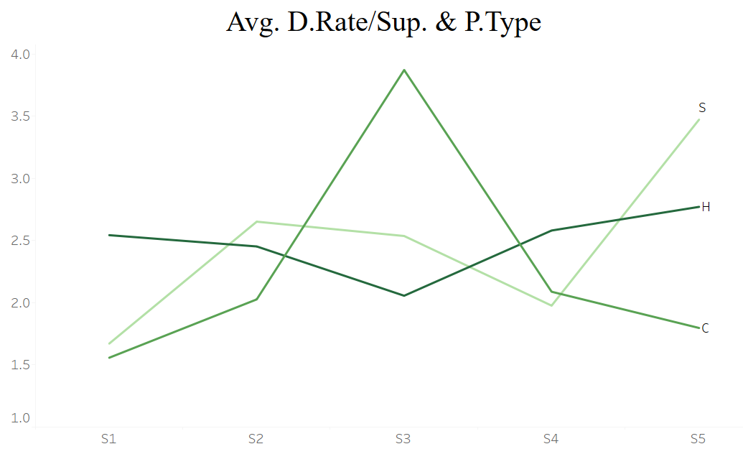
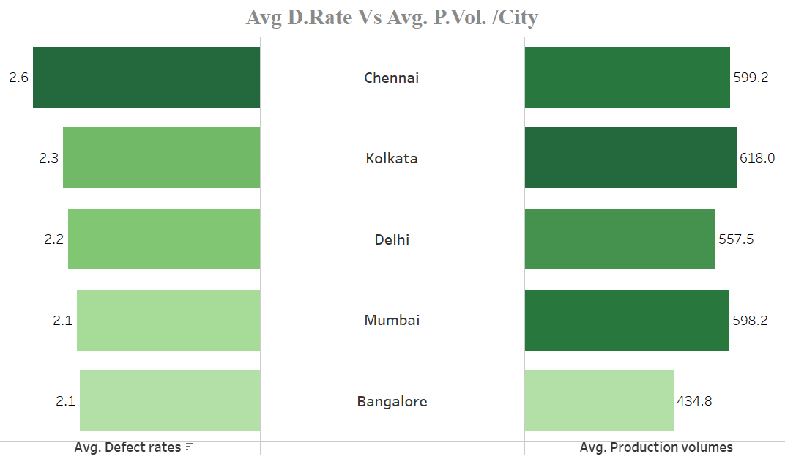
4. Final Recommendations
IV. Quality Analysis
Defect Rate by Supplier:
Supplier 1: Lowest defect rate >> •Maintain Supplier 1 relationship (quality, low defects).
Cosmetics: Supplier 3 - Avoid.
Skincare: Supplier 5 - Avoid.
Defect Rate by City:
Bangalore: Lowest. / Chennai: Highest
Action:
Conduct a root cause analysis in Chennai to identify the reasons behind the high defect rate
key personnel from Bangalore can train and support the Chennai team.
Introduce stricter quality control checkpoints in Chennai
Digital Egypt Pioneers
Supply Chain - Final Project

Slide 30
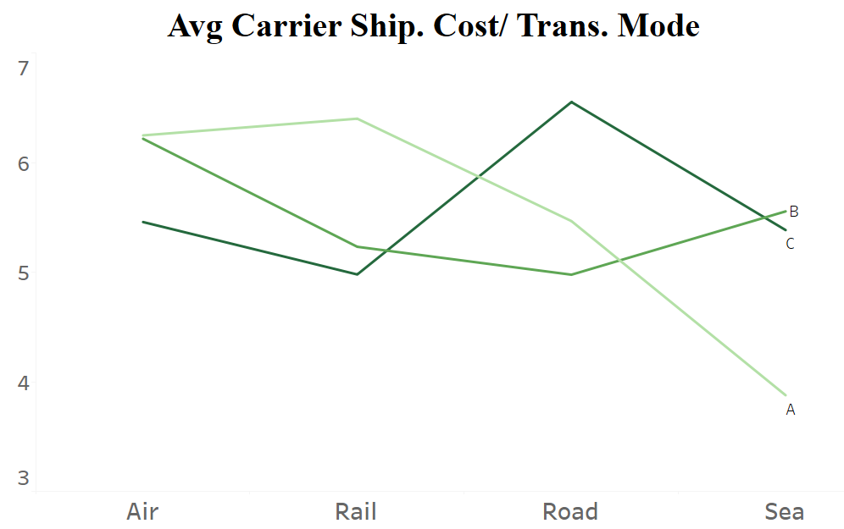
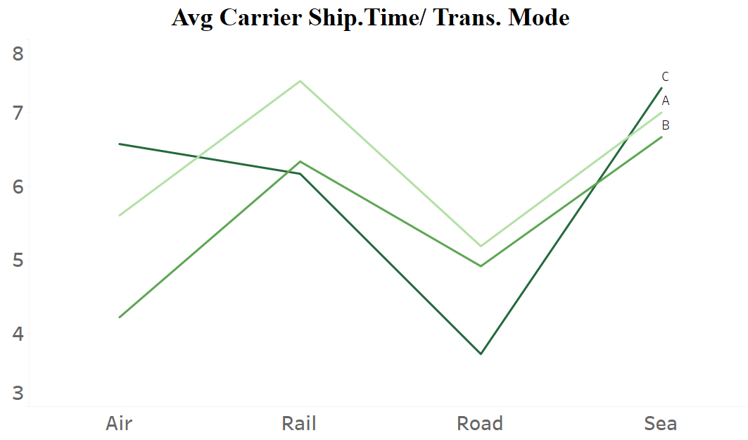
4. Final Recommendations
V. Logistics & Shipping:
Digital Egypt Pioneers
Match transport to urgency:
Non-urgent: Sea >> Carrier (A) – lowest cost is the most recommended.
Urgent: Road >> Carrier (C) – lowest shipping time is the most recommended.
Top Carrier
Carrier B (most used carrier with lowest shipping time)
Action: Being broad across cities and reliable should be recommended in case of offering good shipping rates.
Transport Mode Utilization
Sea freight underutilized
Action: Recommended for non-urgent orders
Supply Chain - Final Project

Slide 31
SUPPLY CHAIN PROJECT
Data Analyst Specialist Track
Digital Egypt Pioneers
THANK YOU
* For Full Project Attachment

